Slide 1
Analysis of Actor-Critic Algorithms
And Variants - Results
Abhishek R

Slide 2
CartPole - V0
Observation
Type: Box(4)
Actions
Type: Discrete(2)
Num | Observation | Min | Max
0 | Cart Position | -2.4 | 2.4
1 | Cart Velocity | -Inf | Inf
2 | Pole Angle | ~ -41.8° | ~ 41.8°
3 | Pole Velocity At Tip | -Inf | Inf
Num | Action
0 | Push cart to the left
1 | Push cart to the right

Slide 3
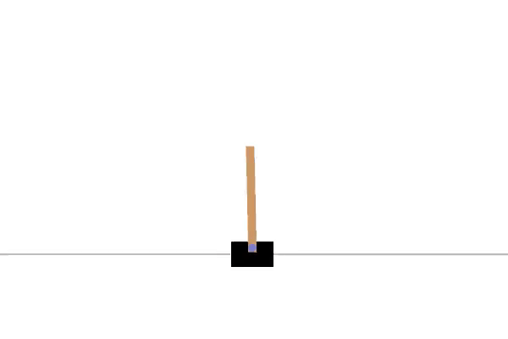
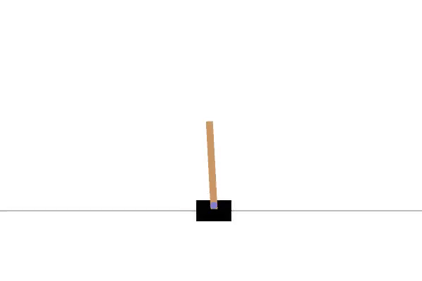
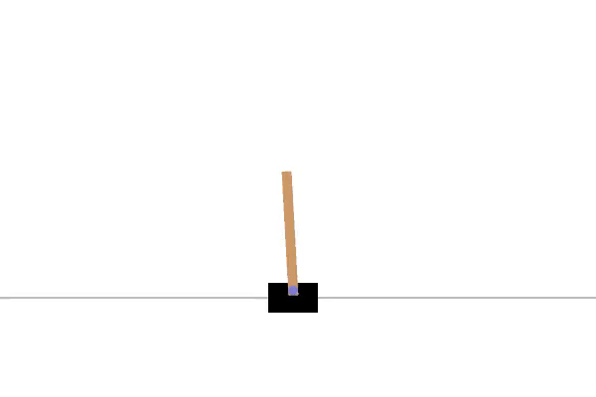
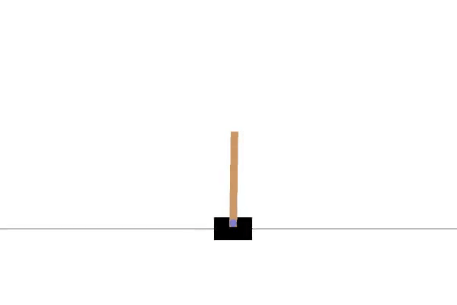
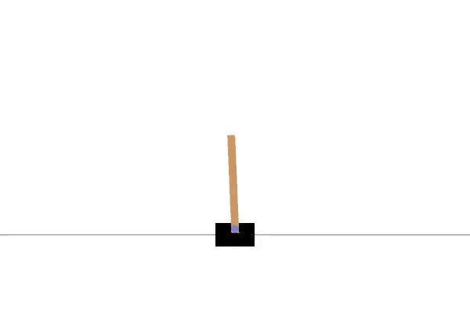


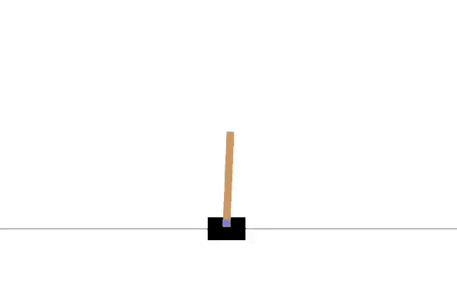

Reinforce-Baseline A2C Konda

Slide 4
Acrobot - V1
Observation
Type: Box(6)
Actions
Type: Discrete(3)
Num | Observation | Min | Max
0 | cos(theta1) | -1 | 1
1 | sin(theta1) | -1 | 1
2 | cos(theta2) | -1 | 1
3 | sin(theta2) | -1 | 1
4 | thetadot1(angular velocity) | -4𝜋 | 4𝜋
5 | thetadot2 | -9𝜋 | 9𝜋
Num | Action
0 | +1 torque on the joint
1 | 0 torque on the joint
2 | -1 torque on the joint

Slide 5
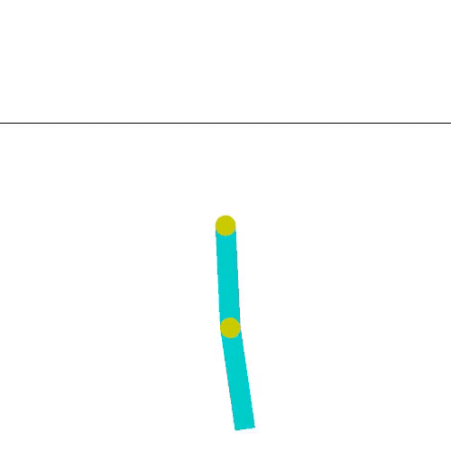
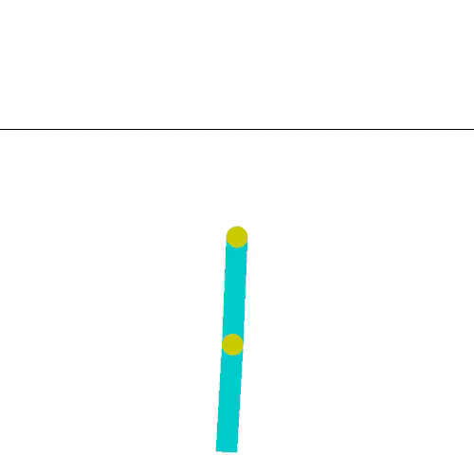
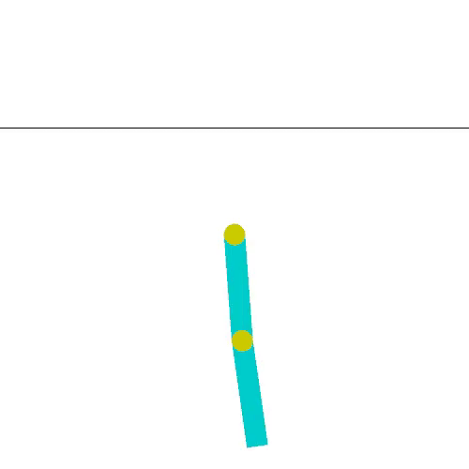
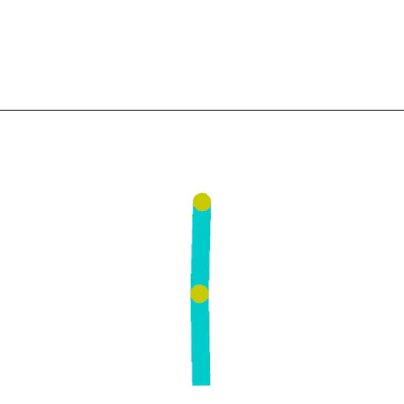
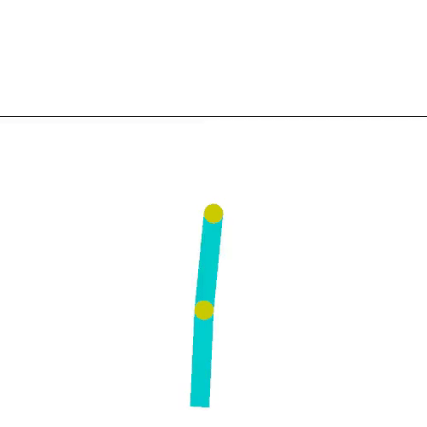
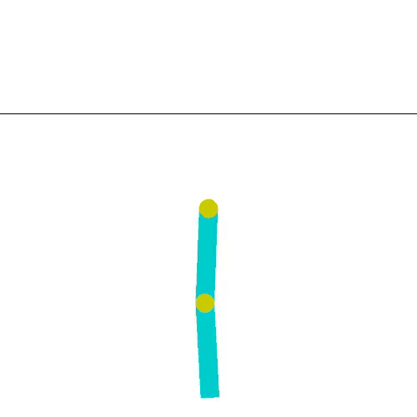
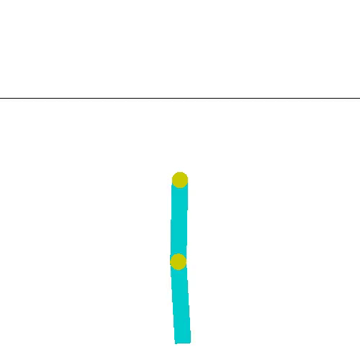
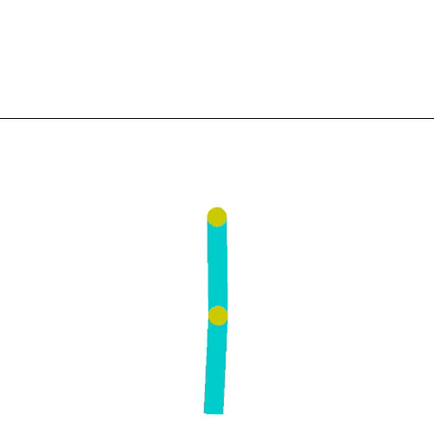
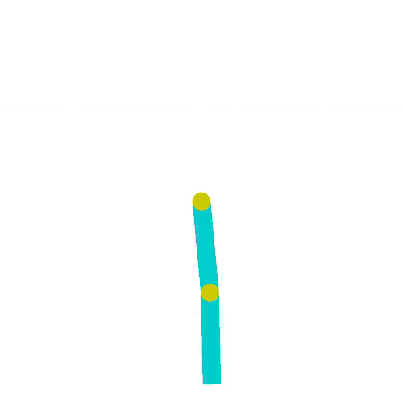
Reinforce-Baseline Q A2C

Slide 6
LunarLander - V2
Observation
Type: Box(8)
Actions
Type: Discrete(4)
Num | Observation | Min | Max
0 | Horizontal Position | -inf | +inf
1 | Vertical Position | -inf | +inf
2 | Horizontal Velocity | -inf | +inf
3 | Vertical Velocity | -inf | +inf
4 | Angle | -inf | +inf
5 | Angular Velocity | -inf | +inf
6 | Left Leg Contact | -inf | +inf
7 | Right Leg Contact | -inf | +inf
Num | Action
0 | Main Engine
1 | Right Engine
2 | Left Engine
3 | Do Nothing

Slide 7
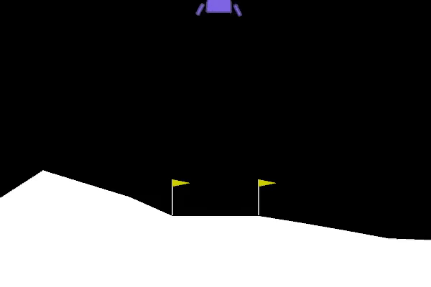
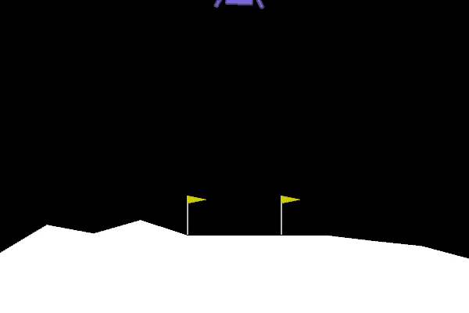
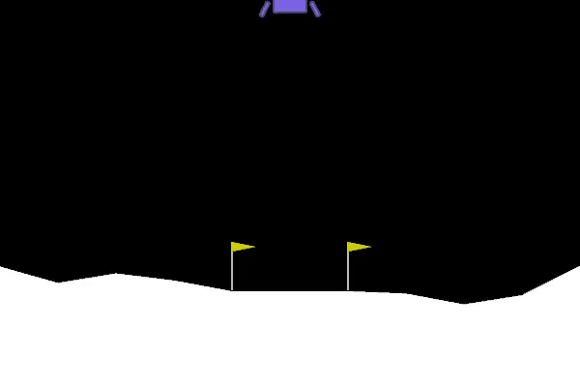
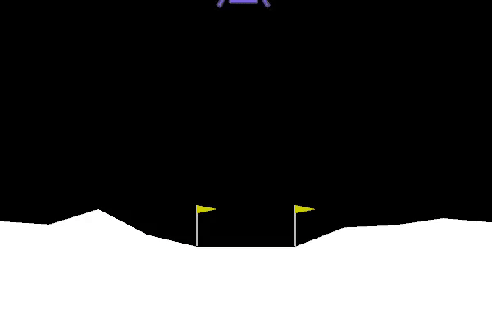
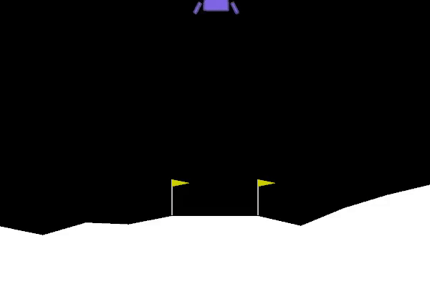
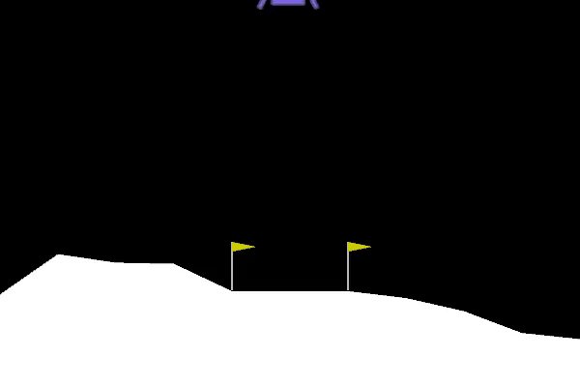
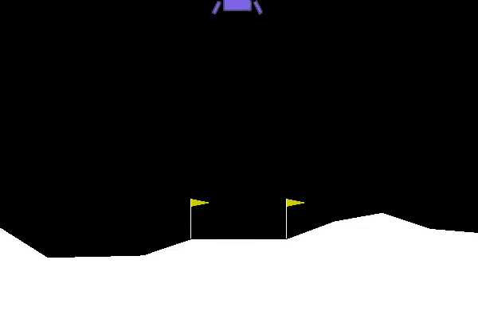
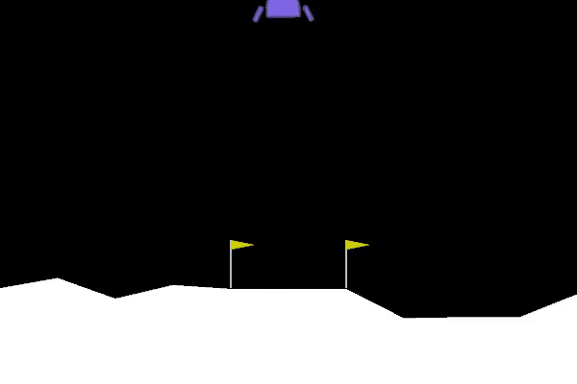
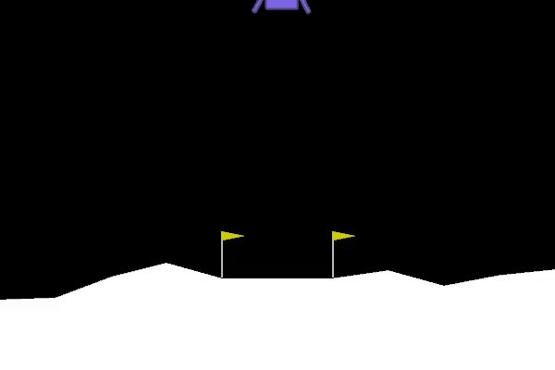
Reinforce-Baseline A2C Konda

